Slide 1


Clustering Songs by Attributes (to find additional song value)
*Supervised and Unsupervised Learning Algorithms for Genre Classification and Song Popularity

Slide 2
The Project – Subject Matter Expertise
Basic Music Theory
Understanding songs attributes
Investment Funds
Recent emergence of songs as asset class – Hipgnosis Songs Fund and Roundhill Music Fund
Music Copyright
Music Royalties – maximizing value of Songs for investors

Slide 3
Songs as Assets – Investing in Songs
Portfolio Management
Emergene of Song Funds
Genre
Investors understand ‘Genre’
Vintage
Investors understand ‘Vintage’
Songs as Investments
Balanced Song Portfolio
Genre Mix
Genre Subjectivity
Vintage Mix
Vintage Earnings Profile

Slide 4
Business Question & Value Add
1. Can we weight a song’s value by it’s features i.e. by song genres, individual attributes or combinations of attributes?
2. Can we derive a song's TRUE genre - i.e. inspect song audio attributes > find clusters of similar song types?
We will implement 2 learning algorithms as follows:
a supervised learning model – feed model the ‘human’ genres
an unsupervised learning model – hide genres > find natural clusters
If we find natural songs clusters:
how do they relate to song value? Do certain features hold more value, i.e are more investable?
can we define them in a way that is understandable to the average human music listener?
cross-reference them against the ‘human’ genre classes to determine how natural the ‘human’ genres are

Slide 5
Modeling
SUPERVISED LEARNING
The models we will look at are:
- KNN
- SVM (multiclass)
- Random Forests
UNSUPERVISED LEARNING
3 clustering methods:
- K-Means
- DBSCAN
- Hierarchical Clustering
For the supervised learning algorithm we will perform hyperparamter optimisation and model selection to choose a best fit model for multiclass classification.
For the unsupervised learning algorithm we will fit and compare 3 clustering methods.

Slide 6
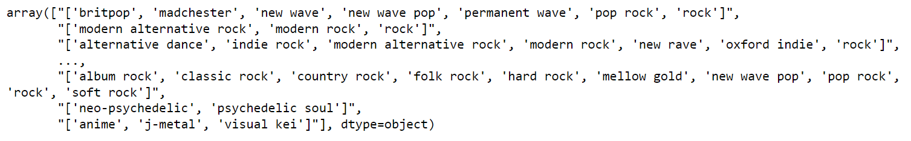
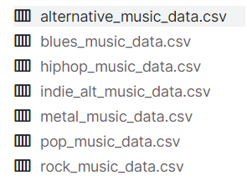
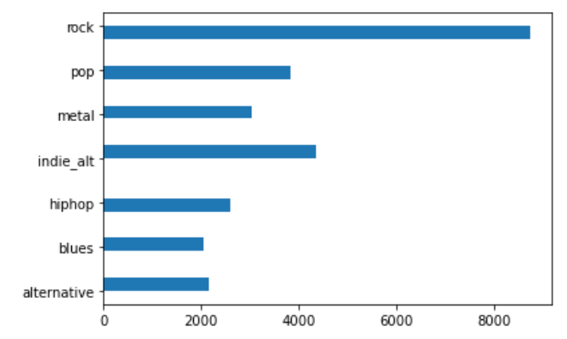
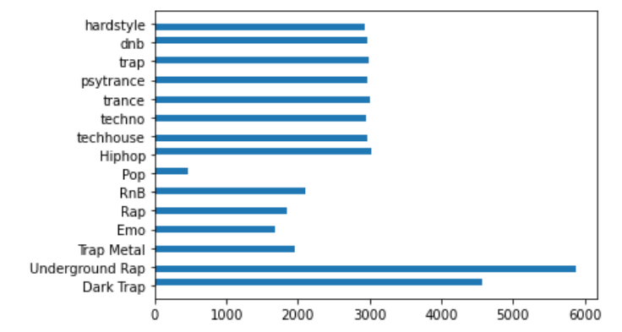
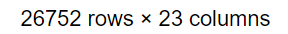

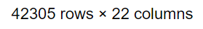
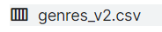
Data Collection and Description
Two datasets were combined….
1. Dataset of songs in Spotify
1,144 messy genre tags
2. Dataset of songs in Spotify

Slide 7
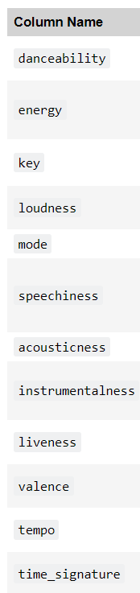
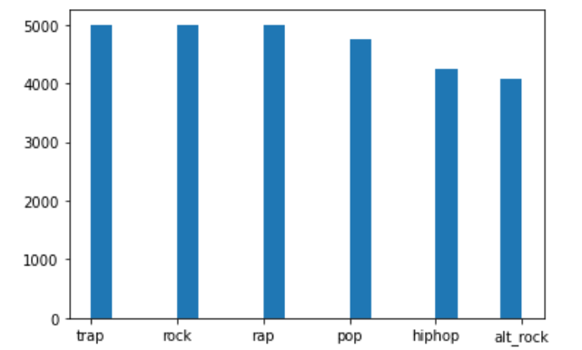
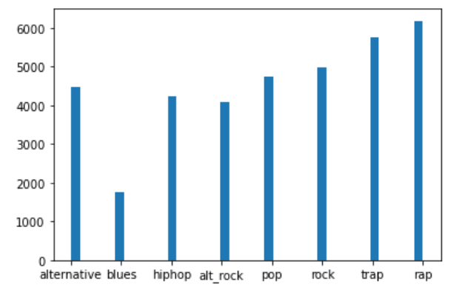
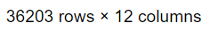
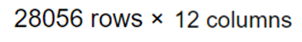
Data Collection and Description
…and cleaned to match up
SUPERVISED LEARNING DATASET
UNSUPERVISED LEARNING DATASET

Slide 8
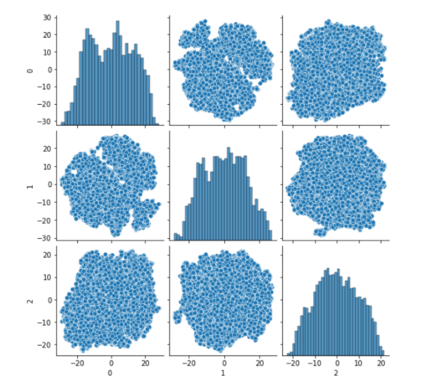
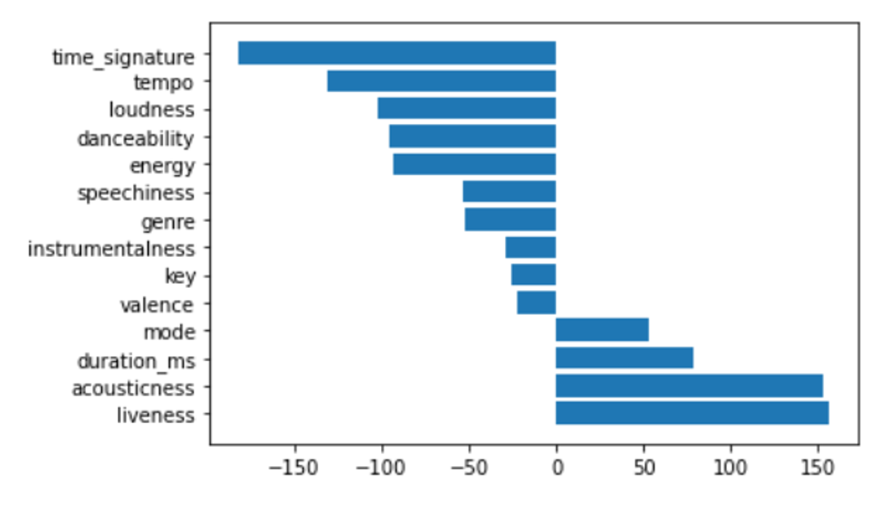
Data Visualization – map genres in space using PCA(n_7) and t_SNE
Feature weight within PCA Components:
t-SNE 3 Components:

Slide 9
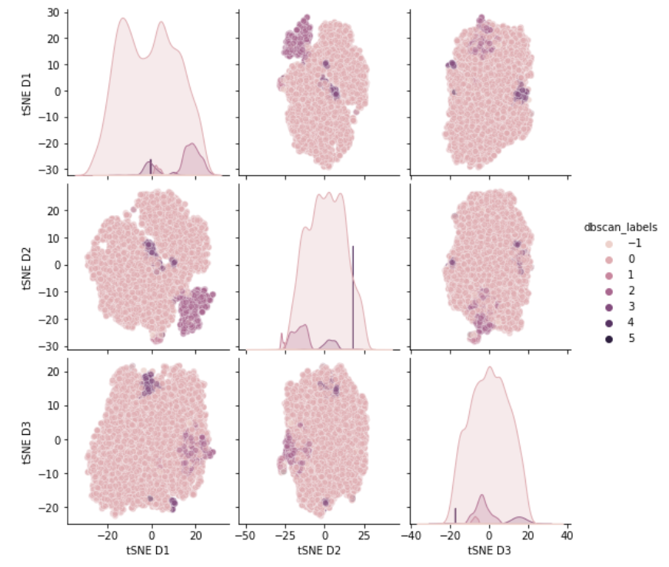
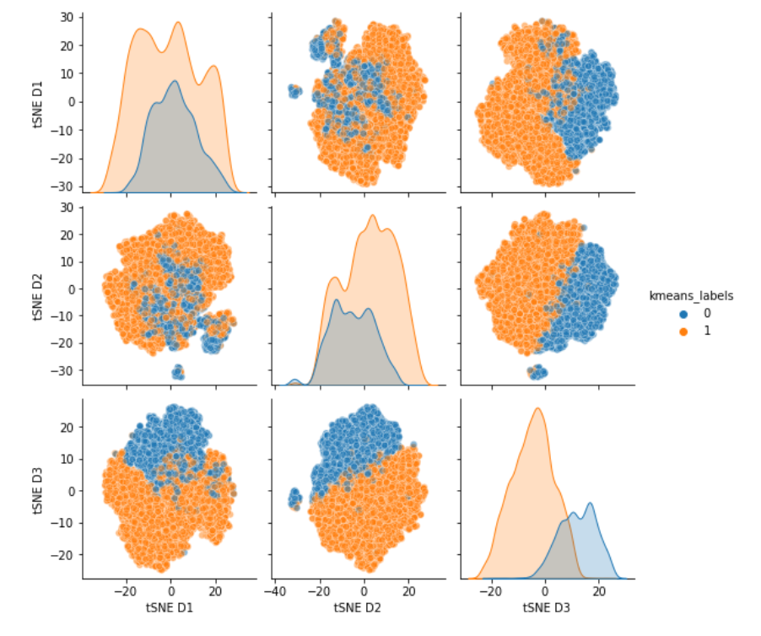
Clustering – First Pass Findings
eps = 2.0, --- n_clusters: 20 --- silhouette: 0.058890698902765846
eps = 2.1, --- n_clusters: 13 --- silhouette: 0.08095891305190783
eps = 2.2, --- n_clusters: 10 --- silhouette: 0.11531371749430948
eps = 2.3, --- n_clusters: 6 --- silhouette: 0.1280624970232836
eps = 2.4, --- n_clusters: 5 --- silhouette: 0.15236696044842565
eps = 2.5, --- n_clusters: 4 --- silhouette: 0.17971373551556463
eps = 2.6, --- n_clusters: 5 --- silhouette: 0.1805791712301547
eps = 2.7, --- n_clusters: 6 --- silhouette: 0.1858397231060538
eps = 2.8, --- n_clusters: 6 --- silhouette: 0.18825518562900945
eps = 2.9, --- n_clusters: 8 --- silhouette: 0.18692995679901697
DBSCAN:
K-Means:

Slide 10
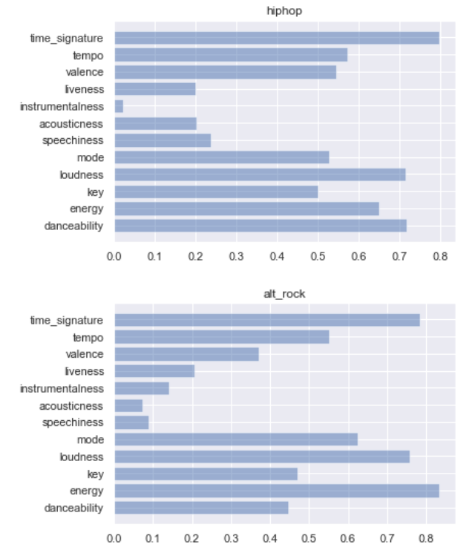
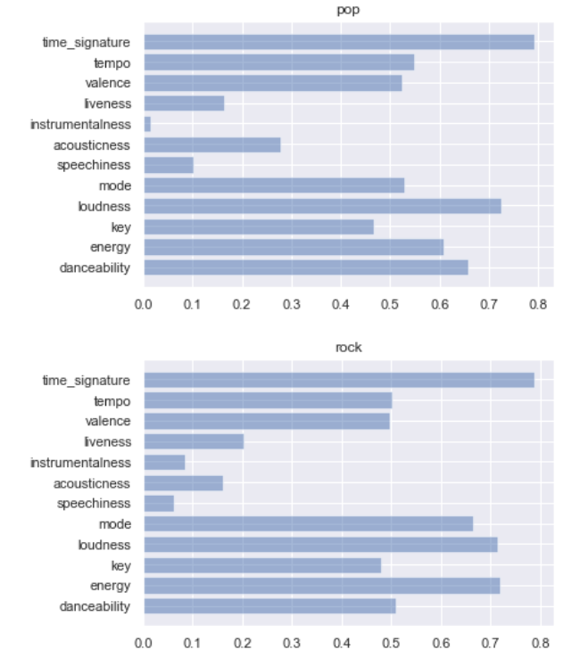
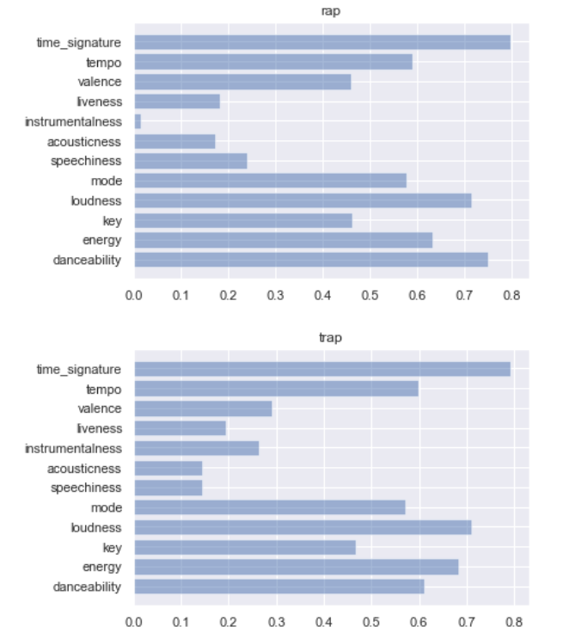

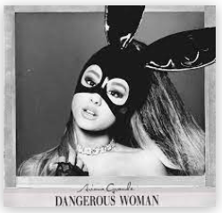
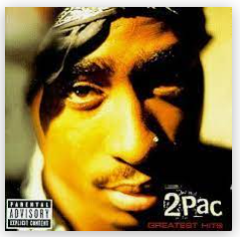



Genre Feature Distributions - Scaled
TOO SIMILAR– DIVERSIFY GENRES! WHAT FEATURES CAN WE ADD?
(….also, figure out FacetGrid)

Slide 11
Project Limitations and Future Developments
Project Limitations
Limited genre / class examples
Limited access to non-musical features of songs
income from 'Synchronisation' i.e. placement of songs in ads, tv, film
earnings profiles
consumption statistics by territory
etc
Future Developments
More diverse genres such as EDM, Country, Latin, Disco, Soul
Song vintage
Song lyrics
There is huge opportunity to develop this model further given access to basic data held privately by copyright owners
Predict future consumption/earnings, access to half yearly or quarterly earnings is not publicly available

Slide 12

Finally… Next Two Weeks
More data from more diverse genres such as EDM, Country, Latin, Disco, Soul
Combine HipHop and Rap, Rock and Metal
Separate RnB, find some Soul to combine it with
Remove ‘Alternative’ genre
Run supervised learning models to teach algorithm how to predict genre from song input
Define and compare clusters (if any) from unsupervised model
Obtain song total consumption figures from Spotify and see if can attribute value to song features

